Slide 1


Review of the Week
Optimizing Blockchain, Ethereum and Crypto Tokens, Security and Anonymity, Notable Projects
Sevgin Mustafov
Blockchain Developer & Course Developer
Academy School of Blockchain
http://kingsland.academy

Slide 2


Table of Contents
What is Ethereum?
Smart Contracts
Decentralized Applications
What is Sidechain?
What is Off-chain Transaction?
Zero Knowledge Proofs
Masternodes
Notable Projects

Slide 3

Ethereum and Crypto Tokens
Smart Contracts, Tokens, DApps

Slide 4
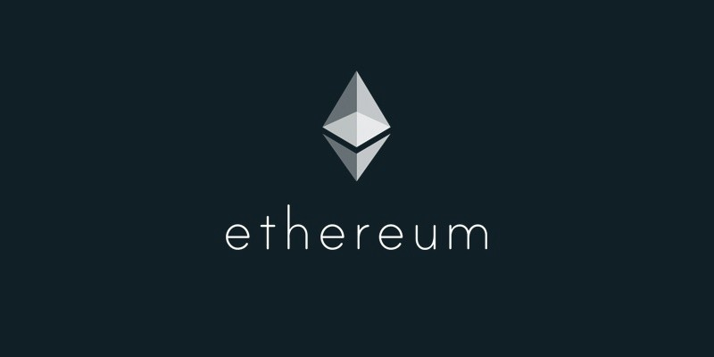
What is Ethereum?
Open-source
Public
“World Computer” that would decentralize
Blockchain-based distributed computing platform
Smart contract functionality
Provides a cryptocurrency token - “ether”
Ethereum Fork – collapse of The DAO project

Slide 5

What is Smart Contract?
First mentioned in 1996, Nick Szabo
Help you exchange
Money
Property
Shares
Transparent
Conflict-free
No middleman needed
Define the rules and penalties
Automatically enforce the obligations

Slide 6
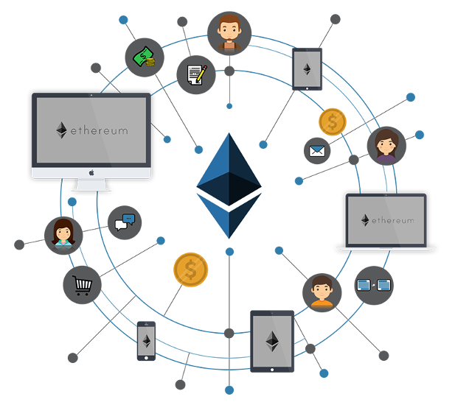
What is Token?
Representation of any fungible tradable good
Coins
Loyalty points
Gold certificates
In game items
ERC20 Token Standard

Slide 7
Token Sale vs. ICO
Initial Coin Offering
Often used to describe Ethereum token launches
Bitcoin clones
Bitcoin produces “coins”
Does one thing
Tokens
Store complex, multi-faceted levels of value
Generated by a Smart Contract System
Multi-functional
Not “offered” but “generated”
Do many things

Slide 8
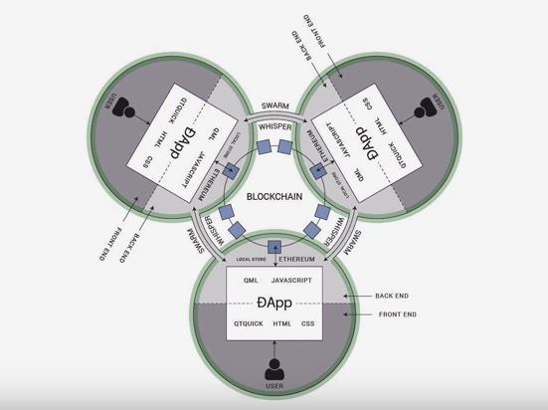
What is Decentralized Application?
Run on a P2P network of computers
Open Source
Decentralized
Incentivized
Protocol
Bitcoin - first DApp

Slide 9

Optimizing Blockchain Network
SegWit, Sidechains, Off-chain transactions

Slide 10

Sharding
Breaks database into pieces
Puts each part on a different server
Move away from “full” nodes
Process isn't exactly trustless

Slide 11

Off-chain transaction
Made on off-chain micropayment channels
Transferring value outside of the blockchain
Lifting from the underlying blockchain
Can be back to the blockchain anytime

Slide 12
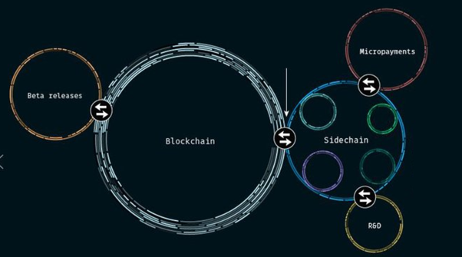
Sidechain
Blockchains separate from Bitcoin’s blockchain
Allow receive and spend Bitcoins using a two-way peg (2WP)
Allows tokens from one blockchain to be securely used within a completely separate blockchain
Moved back to the original chain if necessary
Original chain = "main chain"
Additional blockchains = "sidechains"

Slide 13
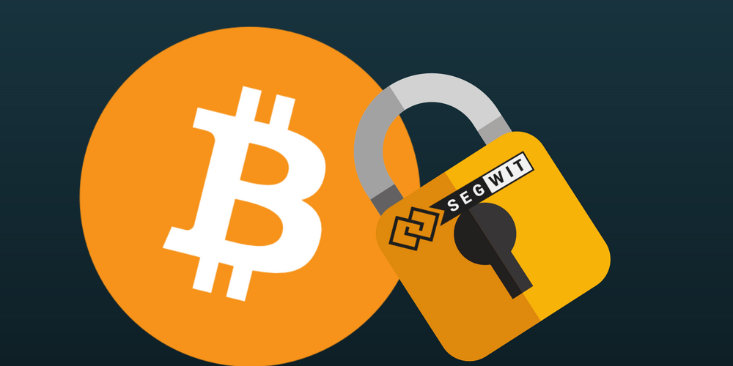
SegWit
Segregated Witness
Splitting the transaction into two segments
Removing the unlocking signature ("witness" data)
Implemented soft fork change in the transaction format
Implemented Litecoin, DigiByte, Vertcoin and Groestlcoin
13

Slide 14
Bitcoin-NG
Serializes transactions
Allows for better latency
Bandwidth without sacrificing other properties
Two types of blocks - micro and key blocks
Divides time into epochs
In each epoch, a single leader is in charge of serializing state machine transitions
Leaders generate blocks

Slide 15

Security and Anonymity of Blockchain Network
Security, Hacks, Privacy and Privacy Coins

Slide 16

Cold Storage
Keeping crypto offline
Security precaution
Dealing with large amounts
Example
Exchange instant withdrawal feature
Minimize the possibility - stealing entire reserve in a security breach
Amount
Keeping majority in cold storage
Cover anticipated withdrawals - kept on the server

Slide 17
Confidential Transactions and Assets
Confidential Transactions
Built on a simple zero-knowledge proof
Prove that the transaction adds up
Did not know the amounts
Confidential Assets
Hides the types of assets
Necessity for privacy in a blockchain with multiple assets
Both
Available from Blockstream
Part of the Elements project

Slide 18
Zero Knowledge Proofs
Guarantee the validity of transactions without revealing additional information
Completeness
Soundness
Zero-Knowledge
Non-interactive zero knowledge proofs
Data verified without interaction from prover

Slide 19
What are Masternodes?
Server connected to the network
Guarantees a certain minimum level of performance and functionality to perform certain tasks related to Private Send and Instant Send
Using Proof of Service (addition to the Proof of Work)
Allowed to vote on governance and funding proposals
Anyone can run a masternode
Proof of Ownership of 1000 Dash
Every 16,616 blocks (~ 28 days) - superblock is created
Randomly selected for payment

Slide 20
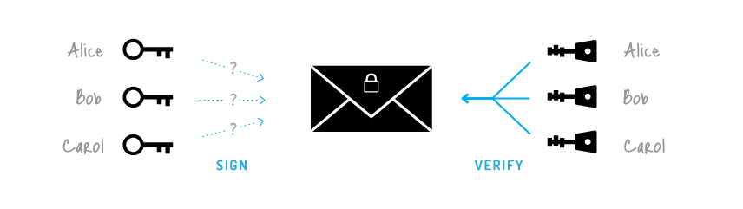
Ring Signatures
Мore sophisticated scheme
Several different public keys
Group of individuals
With own secret and public key
Proving the signer of a given message is a member of the group
Verifier cannot establish the identity of the signer

Slide 21

Notable Projects
AdEx, Propy, Storj, Filecoin, Augur, Gnosis, Steem, LockChain

Slide 22

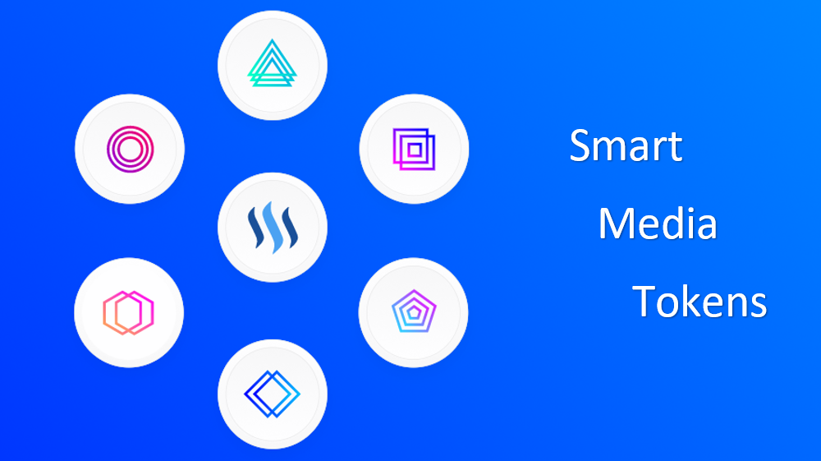
Steem
Blockchain-based rewards platform
Social network that pays its community
Concept
Contribution to the community should be recognized for the value it adds
Two tokens: STEEM and Steem Dollars

Slide 23
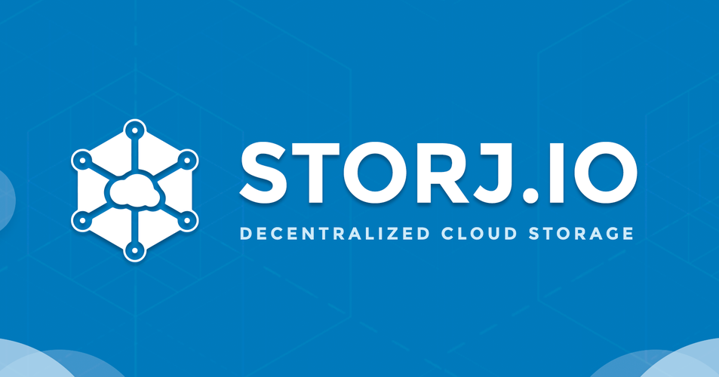
Storj
Decentralized and encrypted cloud storage system
Based on blockchain technologies
End-to-End Encryption
Peer-to-peer technology
Open-source cloud platform
Notes:
Storj presents itself as a decentralized and encrypted cloud storage system based on blockchain technologies.

Slide 24
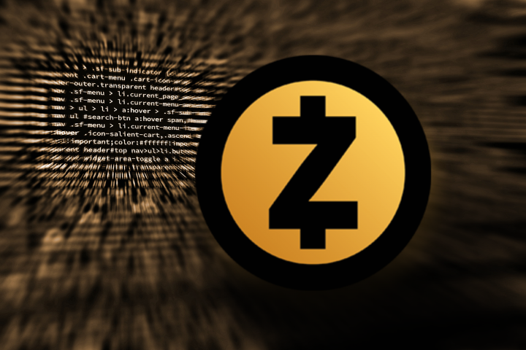
Zcash
Open and Permissionless
Strong privacy protections
Algorithm: Equihash
Zero-knowledge cryptography
Selective transparency of transactions
Shielded transactions hide
Sender
Recipient
Value
Transactions published on a public blockchain
Private Payment Channel - fast, private payment channel protocol inspired by the Lightning Network

Slide 25

Dash
Unique fully-incentivized peer-to-peer network
Decentralized Governance by Blockchain (DGBB)
Algorithm: X11
InstantSend
PrivateSend
Two-tier architecture:
Miners rewarded for securing and writing transactions to the blockchain
Masternodes

Slide 26

Monero
Algorithm: CryptoNight
Unlinkability
Public address == Randomly created brand new one-time address
Public record does not contain any mention that funds were received
Public address never appear in the public record of transactions
“Stealth address”
Secret view key is used to check each transaction by recipient

Slide 27

Summary
Ethereum – Blockchain-based distributed computing platform with smart contracts
Smart Contacts – Performance of credible transactions without third parties
Decentralized Applications – Run on a P2P network of computers
Sidechain – Allows tokens from one blockchain to be securely used within a completely separate blockchain
Off-chain transaction – Transferring value outside of the blockchain
SegWit – Splitting the transaction into two segments
Zero Knowledge Proof – Guarantee the validity of transactions without revealing additional information
Masternodes – Guarantees a certain minimum level of performance and functionality to perform tasks related to Private Send and Instant Send

Slide 28
Review of the Week
http://www.kingsland.academy

